Slide 1



Cloud Community
Day 2024

Slide 2



Rajani Ekunde
DevOps Engineer
Technical Writer
Public Speaker
LIFT Scholar’24
WWG Pune Co-Organizer

Slide 3

Topic
Harnessing the Power of Google Cloud Functions for Serverless Architectures

Slide 4

Agenda
Understanding Serverless Architecture
What are Google Cloud Functions?
Key Features of Google Cloud Functions
How Google Cloud Functions Work?
Key Advantages
Best Practices for Google Cloud Functions
Demo

Slide 5

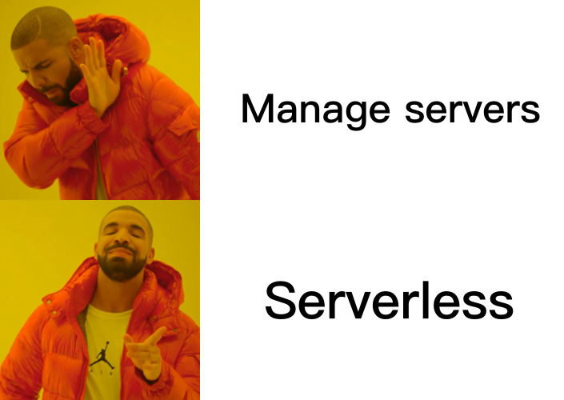
Serverless Architecture
Serverless architecture allows developers to build and run applications without managing server infrastructure.
The cloud provider manages the server, enabling developers to focus on writing code.
On-Demand Execution: Serverless functions run only when triggered, optimizing resource use and reducing costs by eliminating idle infrastructure.

Slide 6
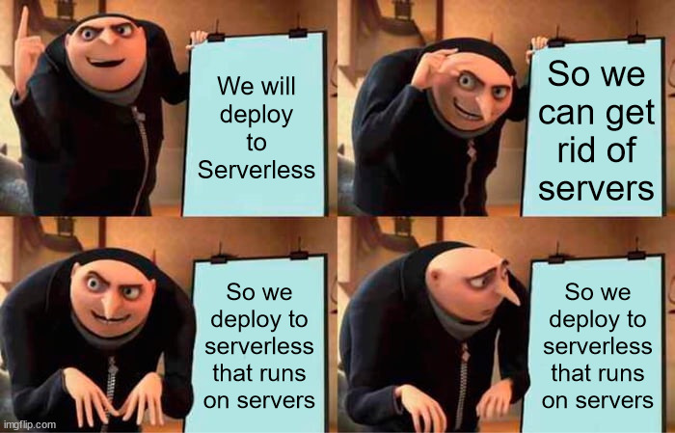
Benefits of Serverless Architecture
No server management.
Automatic scaling.
Pay-as-you-go pricing.
Faster time to market.

Slide 7
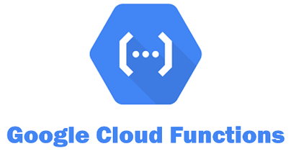
Google Cloud Functions
Google Cloud Functions is a serverless compute service that automatically scales based on the number of incoming requests.
Write simple, single-purpose functions that are triggered by events from your cloud services.
Key Features:
Event-driven execution.
Support for multiple languages (Node.js, Python, Go, Java, etc.).
Integrated with Google Cloud services.

Slide 8
How Google Cloud Functions Work?
Trigger Mechanisms:
HTTP Requests
Pub/Sub Messages
Cloud Storage Events
Execution Flow:
An event occurs.
The event triggers the function.
The function executes the logic.
The result is returned, and resources are automatically managed by Google Cloud.

Slide 9
Key Advantages of GC Functions
Scalability:
Automatic scaling with traffic, no need for manual intervention.
Cost Efficiency:
Pay only for the compute time consumed by your function.
Simplicity:
Reduce the complexity of managing infrastructure, deployment, and scaling.
Seamless Integration:
Easily integrate with other Google Cloud services like Cloud Pub/Sub, Cloud Storage, and BigQuery.

Slide 10
Best Practices for Google Cloud Functions
Optimize Cold Start:
Minimize dependencies and use smaller function sizes.
Monitor and Debug:
Use Google Cloud Monitoring and Logging to keep track of performance.
Secure Your Functions:
Implement proper IAM roles, use environment variables securely, and validate input data.
Versioning and Rollbacks:
Use function versioning to safely deploy and rollback updates.

Slide 11
Demo

Slide 12

Connect With Me!!

Slide 13


